Slide 1

Parallel Image Filter Pipeline Using Java Concurrency concurrent programming

Slide 2
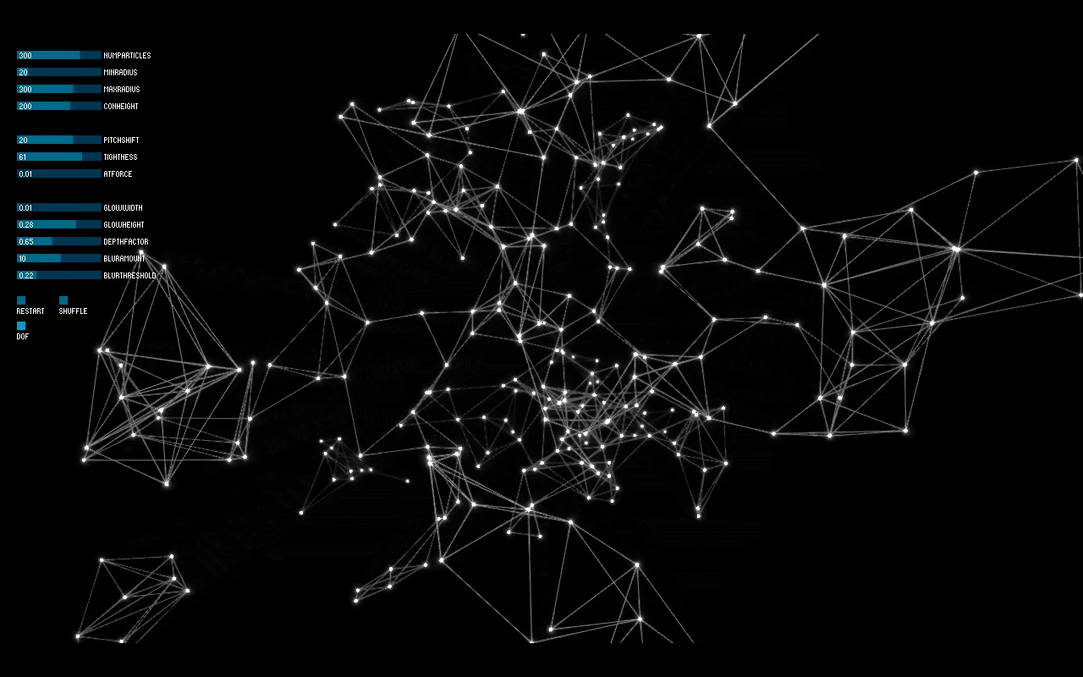
AGENDA
INTRODUCTION
GOALS
Strategy and algorithm
Coding part
Technologies Used
Core filters
Testing methodology
conclusion

Slide 3
INTRODUCTION
Image processing plays a vital role in many modern applications, from photography and medical imaging to computer vision and artificial intelligence.
To improve performance and responsiveness, especially with large images or complex filters, parallel computing techniques are increasingly used.
This project explores how image filtering can be enhanced using parallel programming in Java, aiming to reduce processing time while maintaining quality.
Through graphical visualization and performance measurement, it demonstrates the benefits of combining user-friendly interfaces with efficient computational methods.

Slide 4
→ Apply image filters → Compare sequential vs parallel processing → Measure and export benchmark results → create a Gui
GOALs

Slide 5
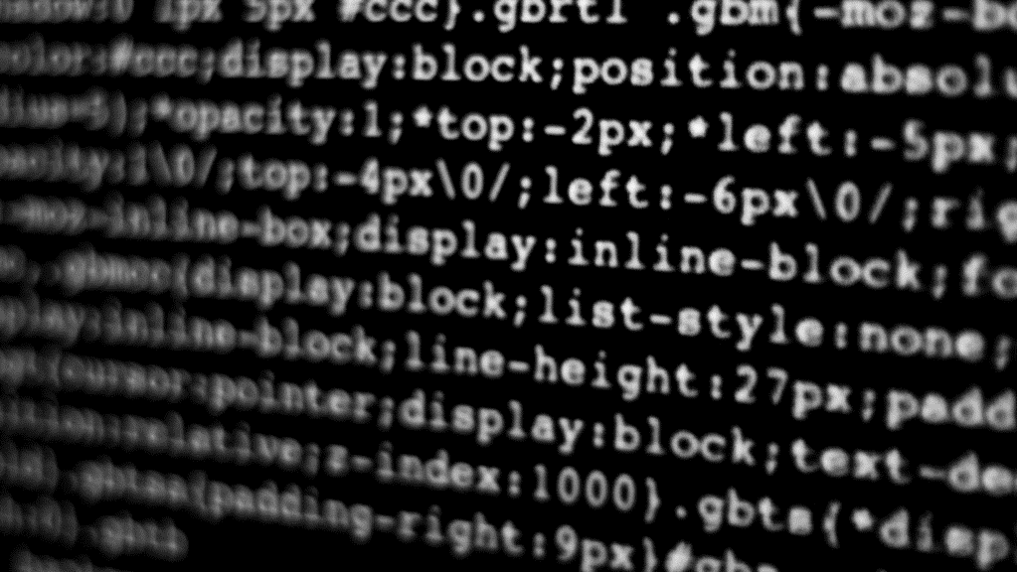
Design and Optimization

Slide 6
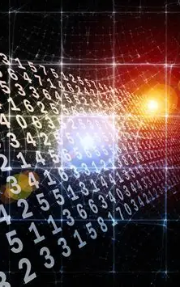
Strategy and algorithm
The sequential baseline processes.
Parallel Convolution Filtering with Fork/Join in Java.
Optimized Image Processing with Recursive Parallelism.
Fork/Join-Based Convolution for High-Speed Image Filtering.
Scalable Image Filtering Using Divide-and-Conquer.
Thread-Efficient Image Filtering with BufferedImage and ForkJoinPool.
Lightweight Parallel Filtering Using Java’s Fork/Join Framework.
Row-Wise Parallel Convolution for Image Enhancement.

Slide 7
Coding part
GO to further details

Slide 8
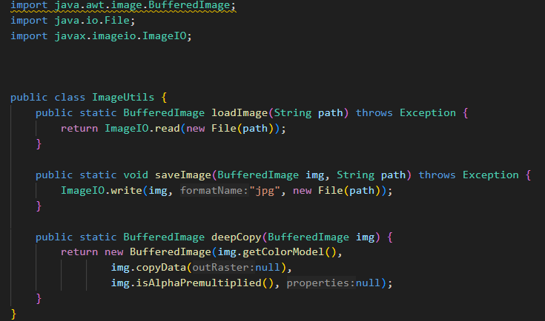
Imageutils.java

Slide 9
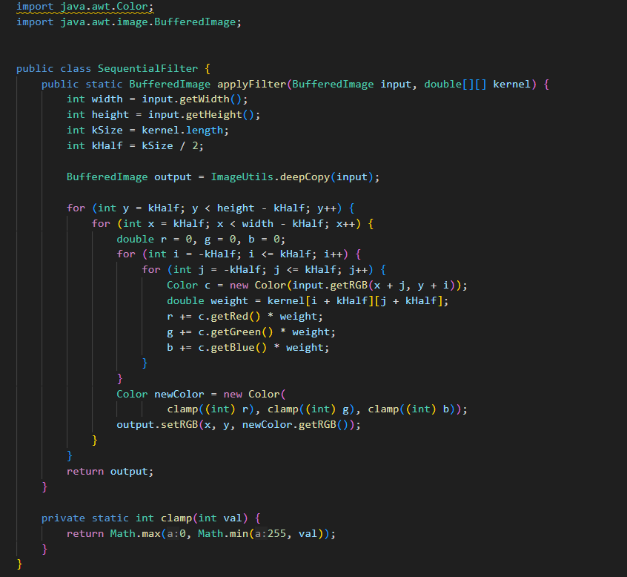
SequentialFilter.java

Slide 10
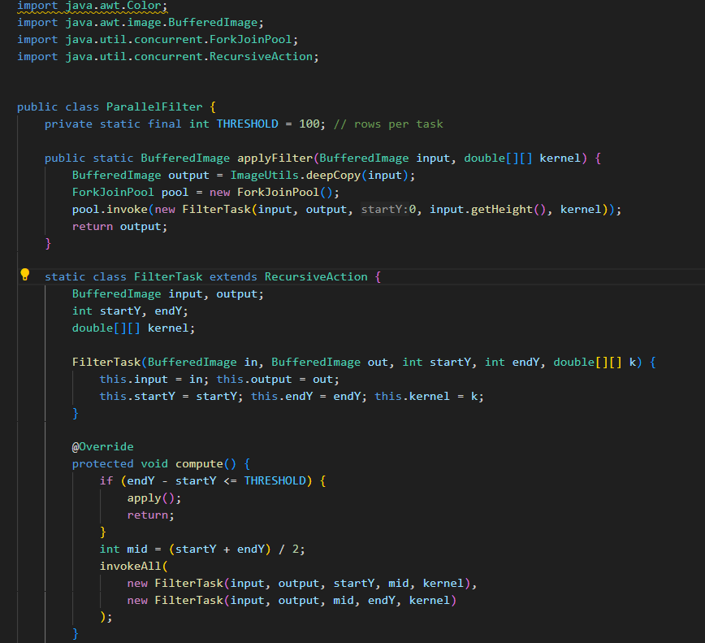
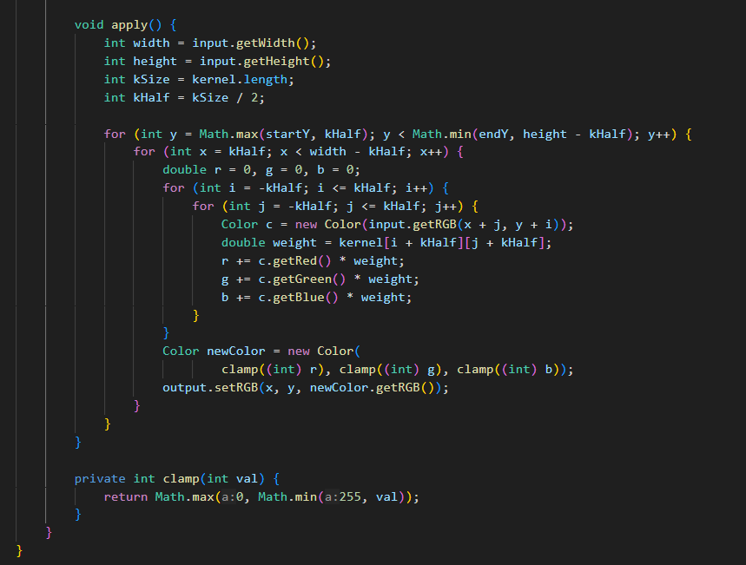
parallelfilter.java

Slide 11
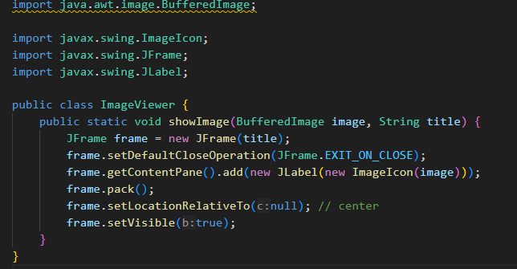
Imageviewer.java

Slide 12
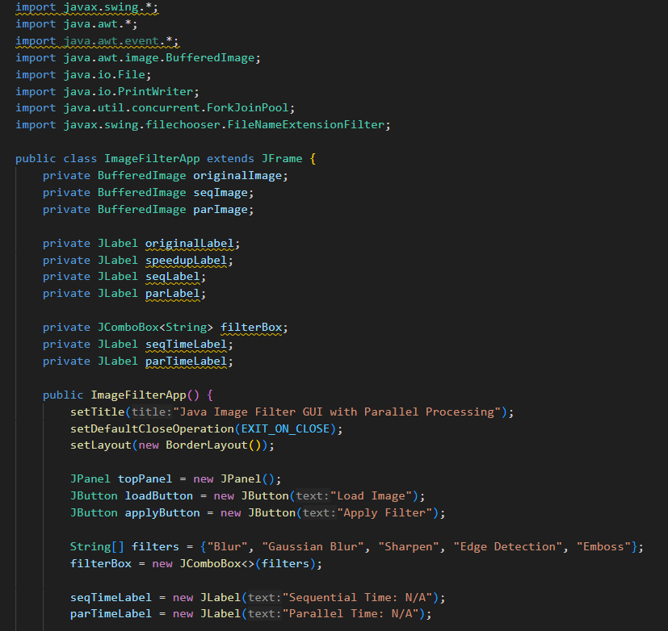
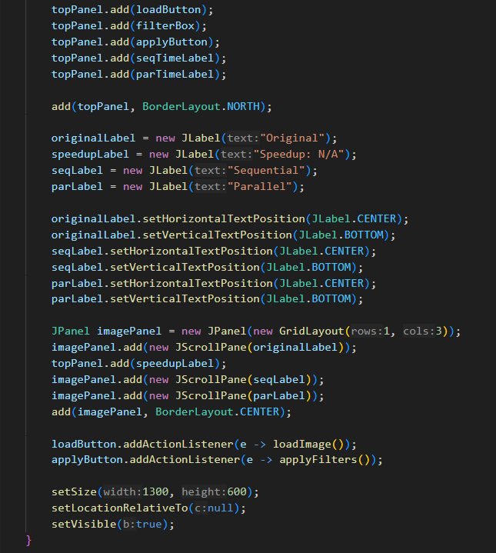
Imagefilterapp.java
GUI

Slide 13
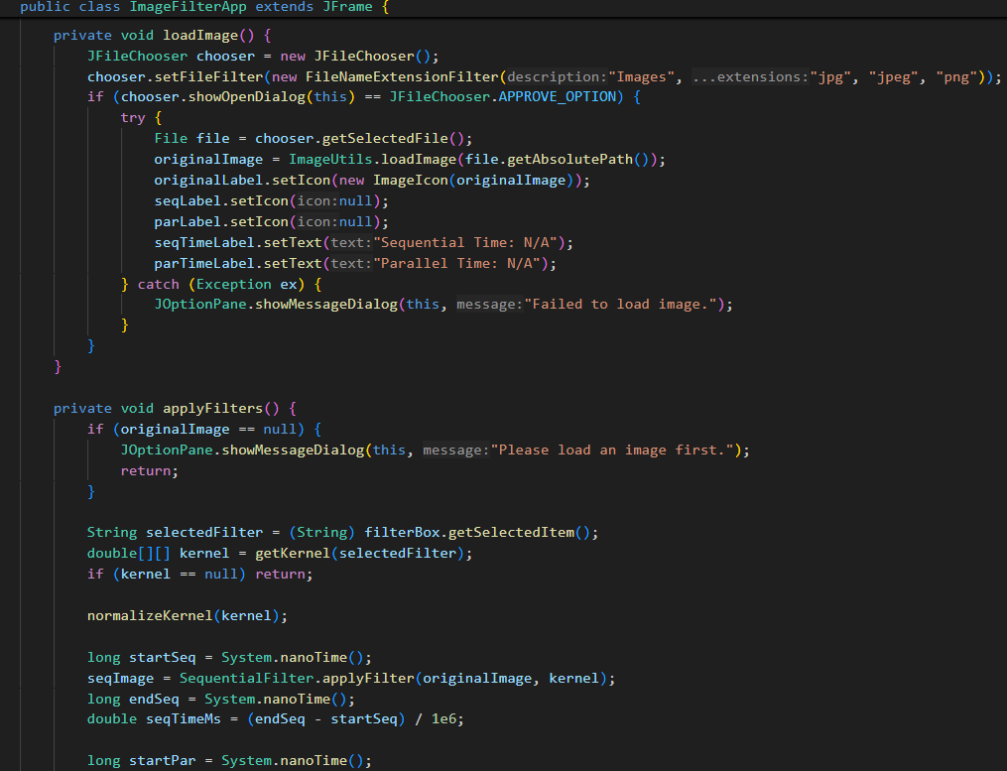
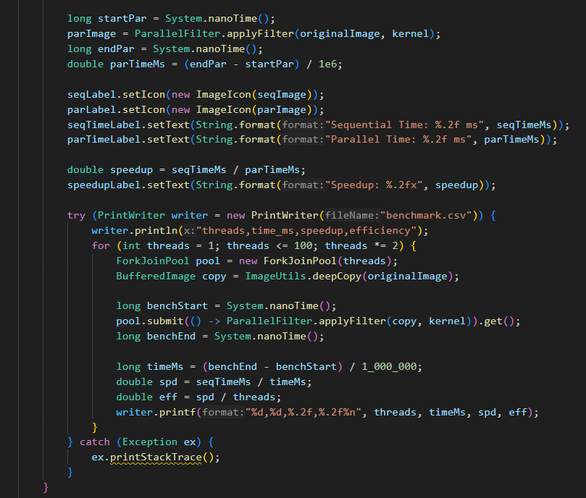
ImageFILTERAPP.java
LOAD & FILTERS

Slide 14
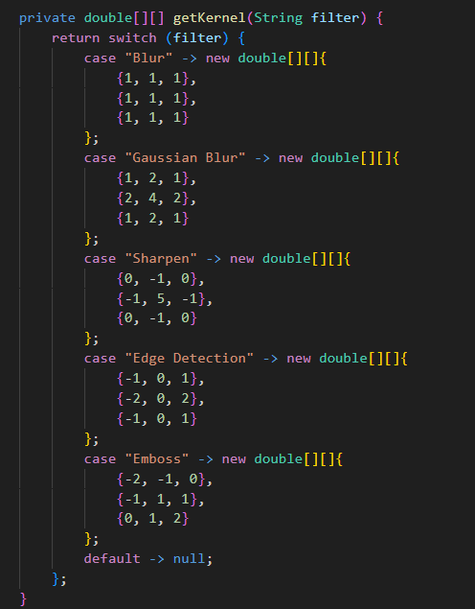
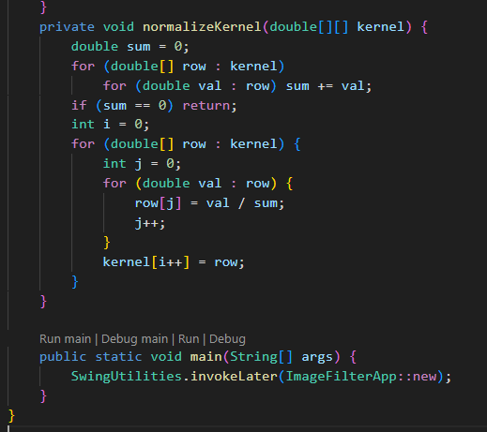
ImageFILTERAPP.java
KERNEL

Slide 15
Technologies Used
Tools used:
Java Flight Recorder for profiling.
VisualVM for memory and CPU usage monitoring.
CSV export of benchmark data → plotted externally.
Technologies used:
CPU: Intel Core i7-9700K
RAM: 16 GB
OS: Windows 11
Java: OpenJDK 17
Swing GUI
ForkJoinPool for parallelism
Gradle for build & run

Slide 16
Box Blur Gaussian Blur Sharpen Sobel Edge Detection Emboss
Core filters

Slide 17

Testing methodology

Slide 18
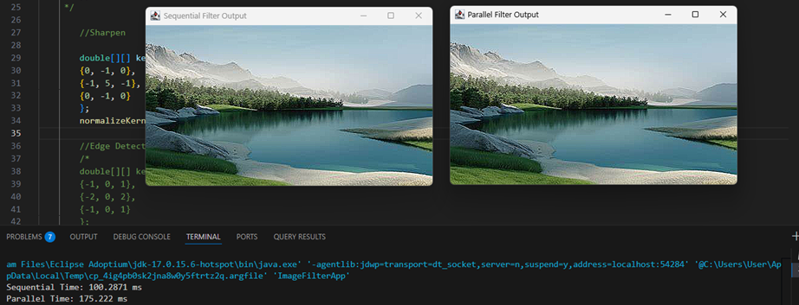
Before Gui

Slide 19


Slide 20
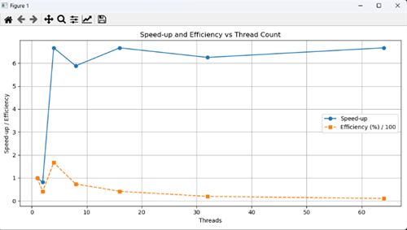
Graphical analysis

Slide 21
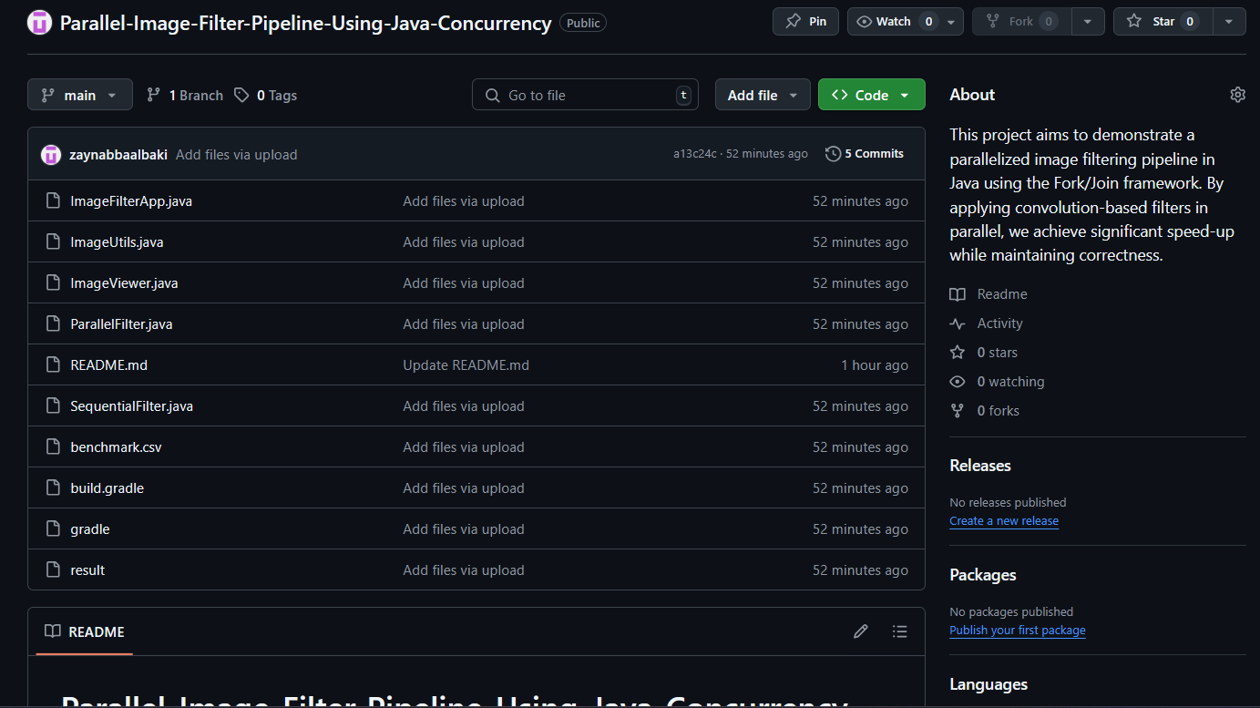
GitHub

Slide 22

conclusion
The Fork/Join framework proved effective in scaling convolution operations, achieving significant speed ups.
Up to 10x speed-up on large images.
Responsive GUI during filtering. Scalable with CPU cores.
Wins: Massive time reduction, higher CPU utilization.
Costs: Slight increase in memory usage and code complexity.

Slide 23

THANK YOU
Dr Mohamad Aoude
Concurrent Programming
https://github.com/zaynabbaalbaki/Parallel-Image-Filter-Pipeline-Using-Java-Concurrency

